Slide 1
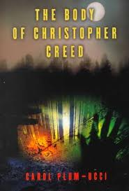
The Body of Christopher Creed
By Carol Plum-Ucci

Slide 2
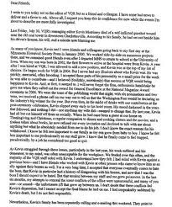
“….I only wish to be gone. Therefore I AM.”
Christopher Creed wasn’t a normal kid who got along with everyone. He was different and constantly getting on everyone’s nerves.

Slide 3
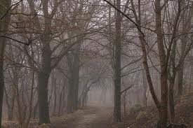
Murders, runaways and Suicides were all things that the police that lived in Steepleton Could have dealt with. But Chris just disappeared leaving no trail behind. He was just gone.

Slide 4
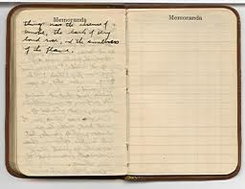
Since no one wanted to take the blame, the small town turns on each other, pointing fingers at everyone so long as they aren’t involved with it.

Slide 5
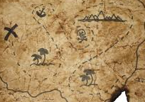
Since no trails were left behind,three kids go on a wild goose chase that leads to be more trouble than they imagined.

Slide 6
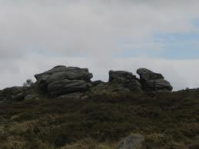
Nothing has been left behind to give the slightest hint to what Christopher was thinking when he sent his good-bye email. With some many questions left unanswered, the mystery of finding drives everyone crazy.

Slide 7
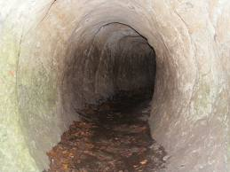
No one knows why. No one knows where he is. No one knows if he is even alive. It could have been suicide. It could have been murder. He could have just runaway. But no one knows.

Slide 8
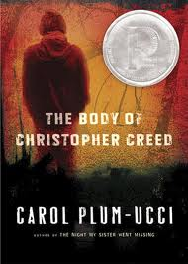
Find the answers by reading The Body of Christopher Creed by Carol Plum-Ucci.

